Slide 1
Introduction to Psychology
Sumitava Mukherjee
Sensation and Perception
All images © respective authors. Some used from the chapter “Perception and Attention” from Robert Solso’s Cognitive Psychology only for demonstration.
Some searched using Creative commons for reuse.

Slide 2
“computational mind/brain”
How the brain encodes and processes information?
Perceive information about the environment
Attend to the world
Process information during the initial stages
[The mind is what the brain does]

Slide 3
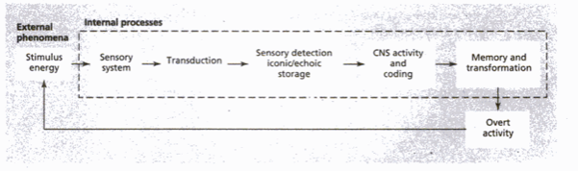
Stages of information processing
External phenomenon and
Internal processes and structures

Slide 4
Sensation
Initial detection of energy from the physical world
The study of sensation deals with:
    The structure and processes of the sensory mechanism
(the ear, the eye, and so on)
    The stimuli that affects those mechanisms

Slide 5
Perception
Involves higher order cognition in the interpretation of sensory information
Initial detection of stimuli (Sensation)
Interpretation of the things we sense (Perception)
Sensory system - contact between the inner world and the external world

Slide 6
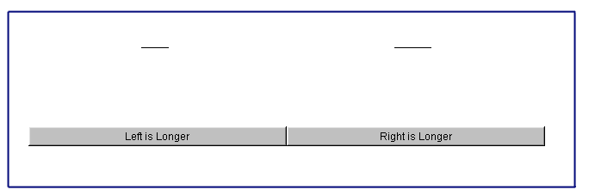
Perceiving differences

Slide 7
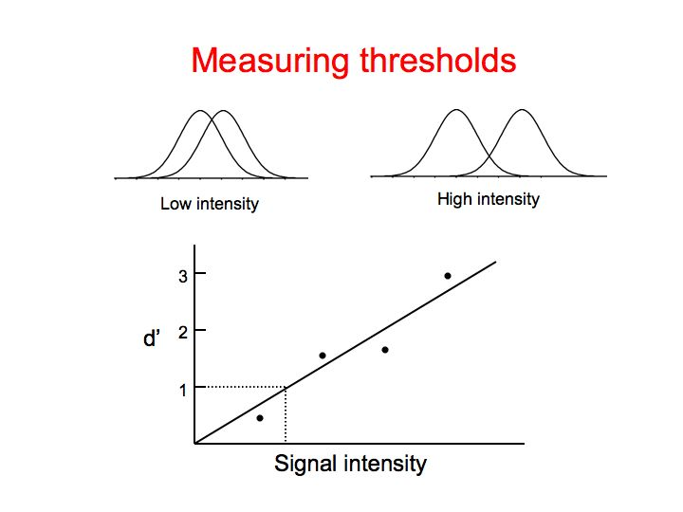

Slide 8
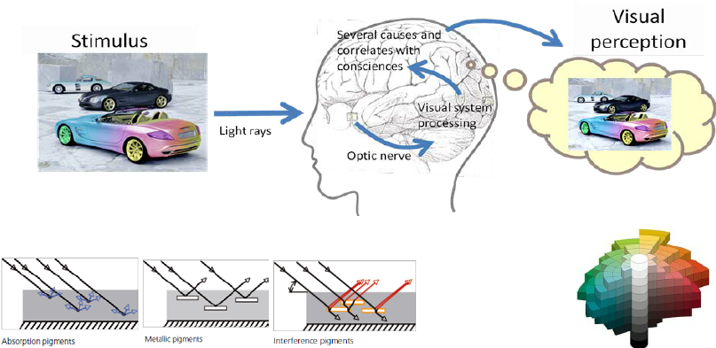
The (bio-computational) system

Slide 9
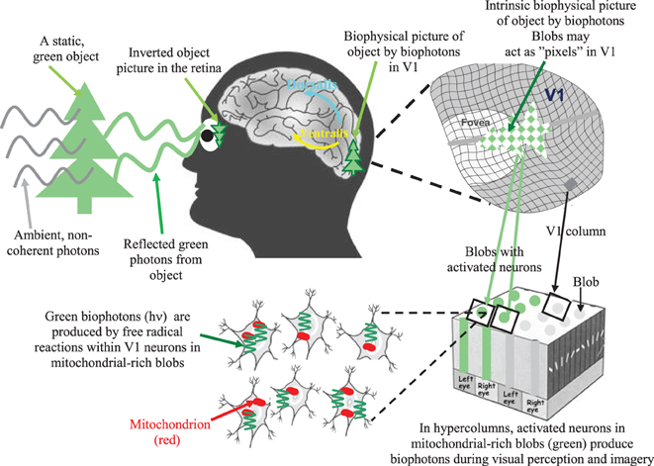

Slide 10
How do we interpret the world?
Nativist: knowledge is innate, given a priori. (Descartes)
empiricist approach, our knowledge comes to us a posteriori from the senses -- either through our sensory experiences, or through our reflections on our sensory experiences. (Locke, Hume)
Kantian synthesis. Most knowledge is acquired through sensory experience, but sensory experiences are themselves structured by innate schemata (synthetic a priori) [ex. causality, temporal sequence]

Slide 11
Perceptual Illusions
Why does the mind distort reality?
Distinction between sensations and the perceived interpretation of those experiences
What our sensory system receives and the mind interprets

Slide 12
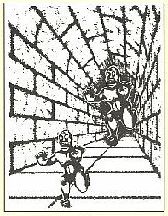
Size-Distance Relationship
Object size is inferred from perceived distance and retinal image size
If 2 objects have the same retinal image size (i.e., are the same real size), the object appearing further away is seen as larger

Slide 13
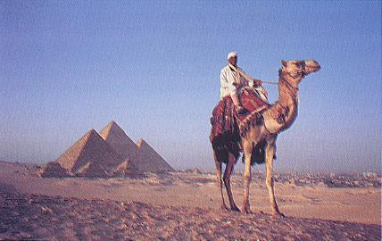
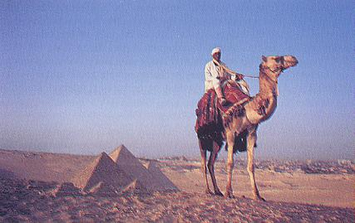
Size-Distance Relationship

Slide 14
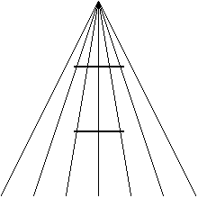
The Ponzo Illusion
Gregory’s theory
The visual system makes hypotheses about distance to objects based on evidence in the image. Interpretation of size follows.

Slide 15

Müller-Lyer illusion

Slide 16
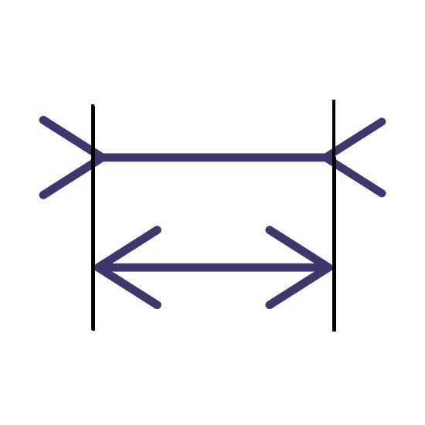
Müller-Lyer illusion

Slide 17
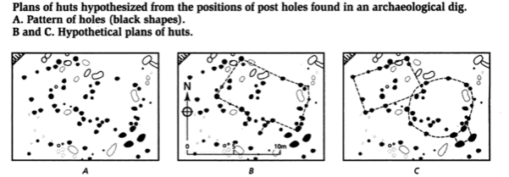
Perceptual processing
Perceptions are influenced by:
Past knowledge, previous hypotheses, and prejudices, as well as sensory signals
Common processing
Individual differences in perception

Slide 18
Perceptual Scope
Fundamental way of perception
  Focus (Zoom in) vs Distribute (zoom out)
  Can be instigated by Global and local processing styles
  Global/Local perceptual processing is linked conceptually
  Global/Local can work as a common framework and a generic mechanism which regulates focus

Slide 19
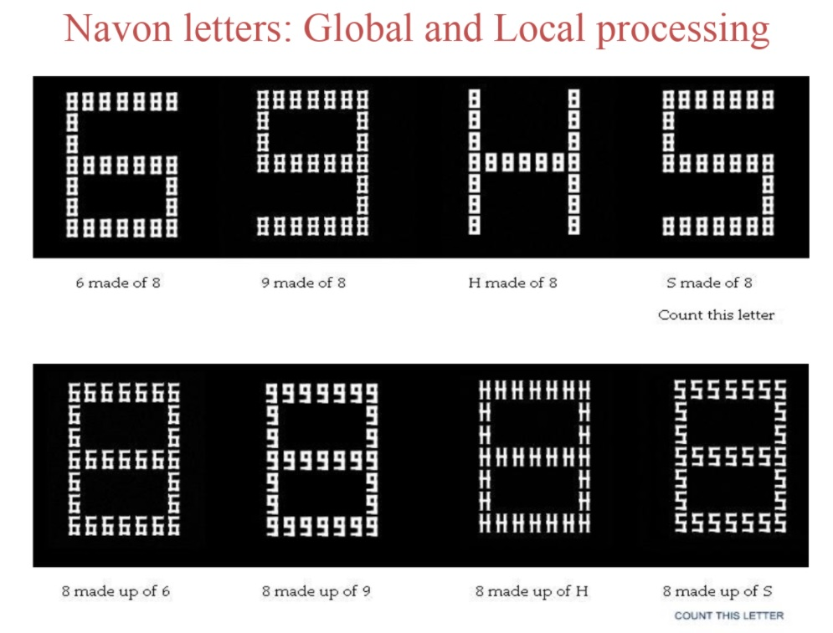
Perceptual scope

Slide 20
Perceptual Span
How much can we experience at a brief exposure
An early component in the processing of information
World is teeming with stimuli, a huge number of which are within the range of sensory detection
How many of these sensations are available for further processing?
Preperceptual sensory store and short-term memory

Slide 21
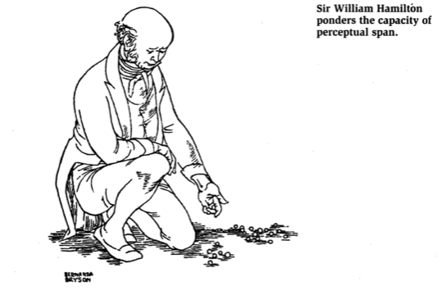
Sensory memory
What are the boundaries of these
transitory impressions?
How long do they last?
How much can be perceived in
how short a time?

Slide 22


Slide 23
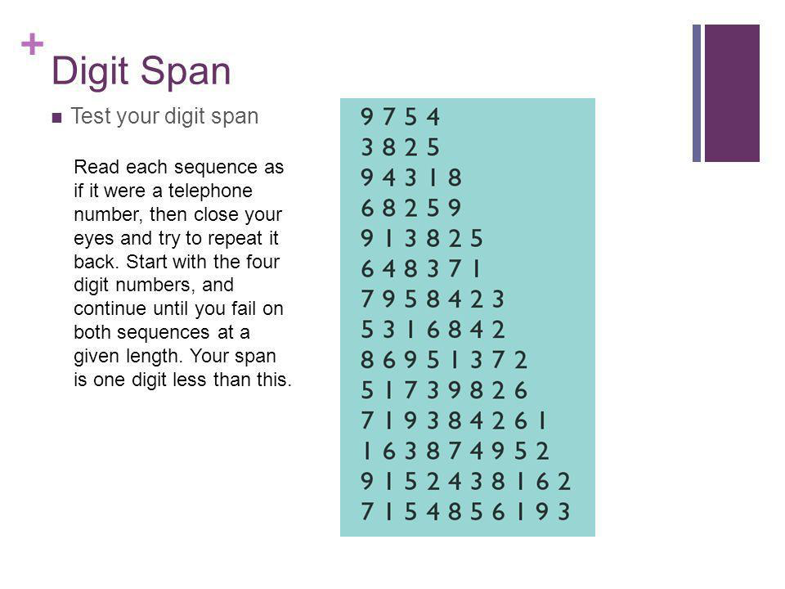

Slide 24
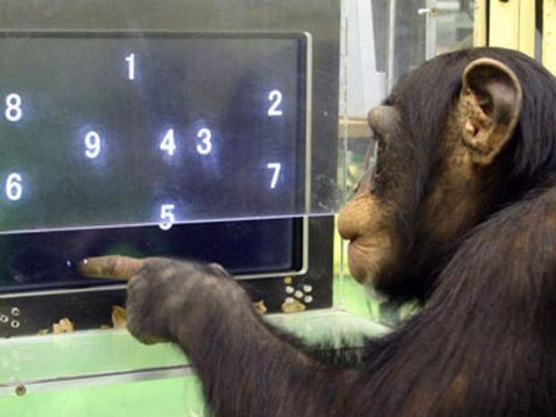

Slide 25
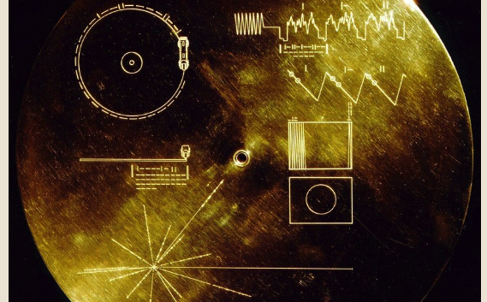
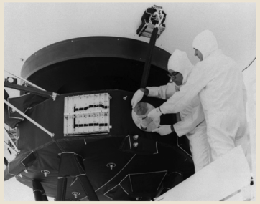
Form perception about ourselves

Slide 26
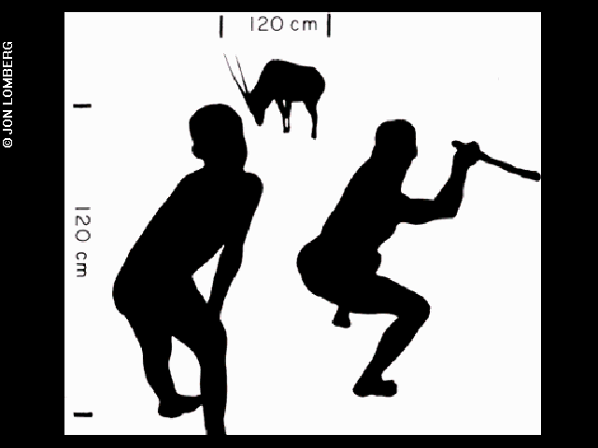
Examples of form percepts from Voyager gold disk

Slide 27
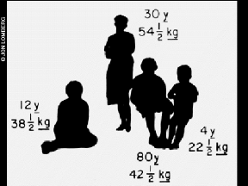
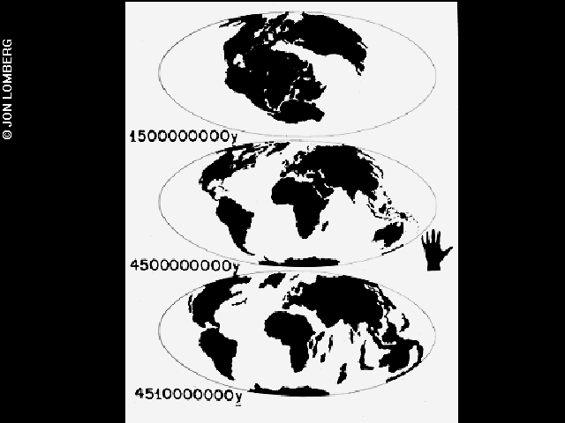
Magnitudes and form

Slide 28


